Slide 1
Create a server on AWS
Specifically Linux

Slide 2
Create an AWS account
aws.amazon.com/Account/Sign-Up‎

Slide 3
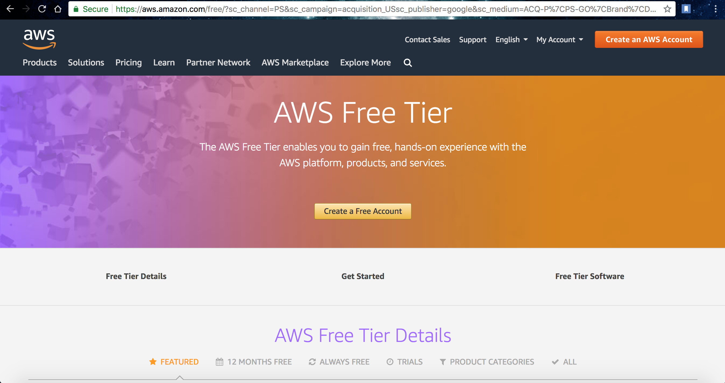

Slide 4
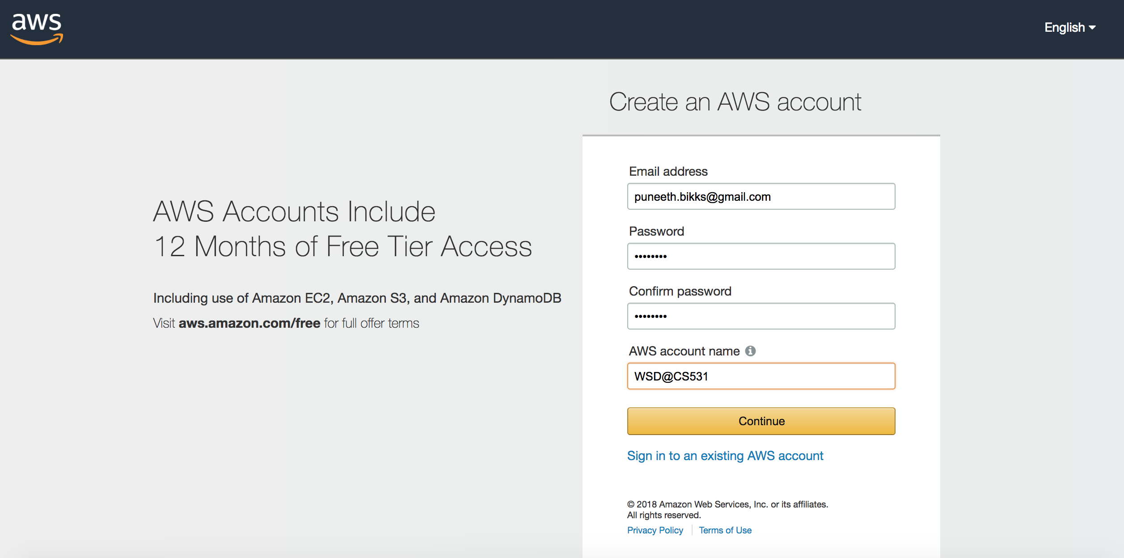

Slide 5
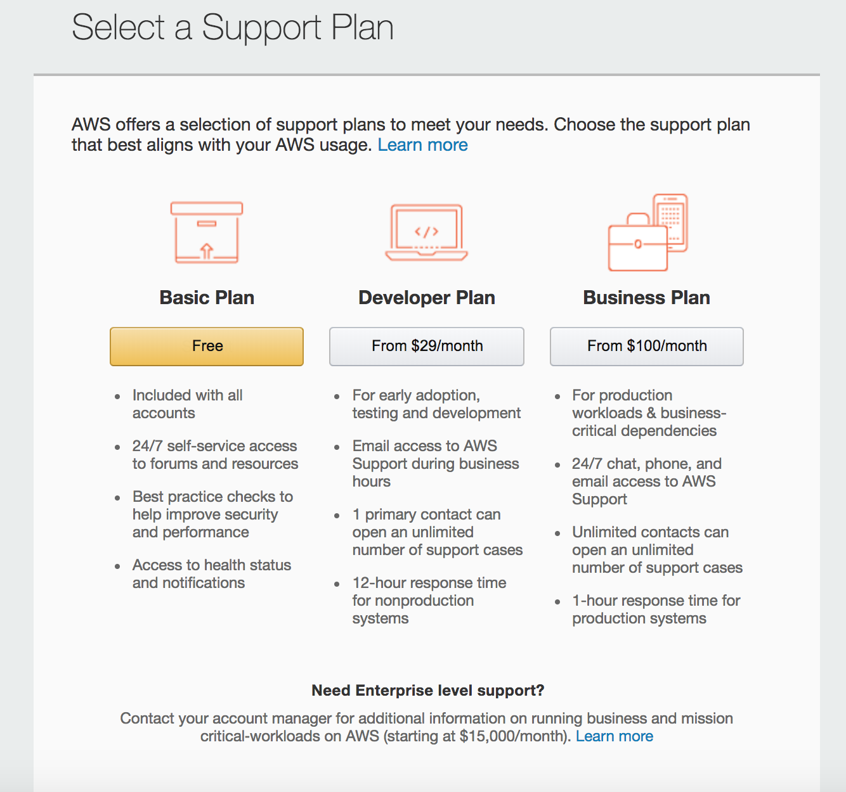
Choose your plan…

Slide 6
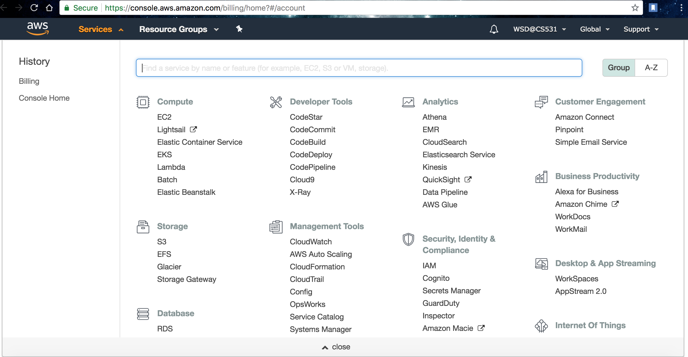
Click on ‘Services’

Slide 7
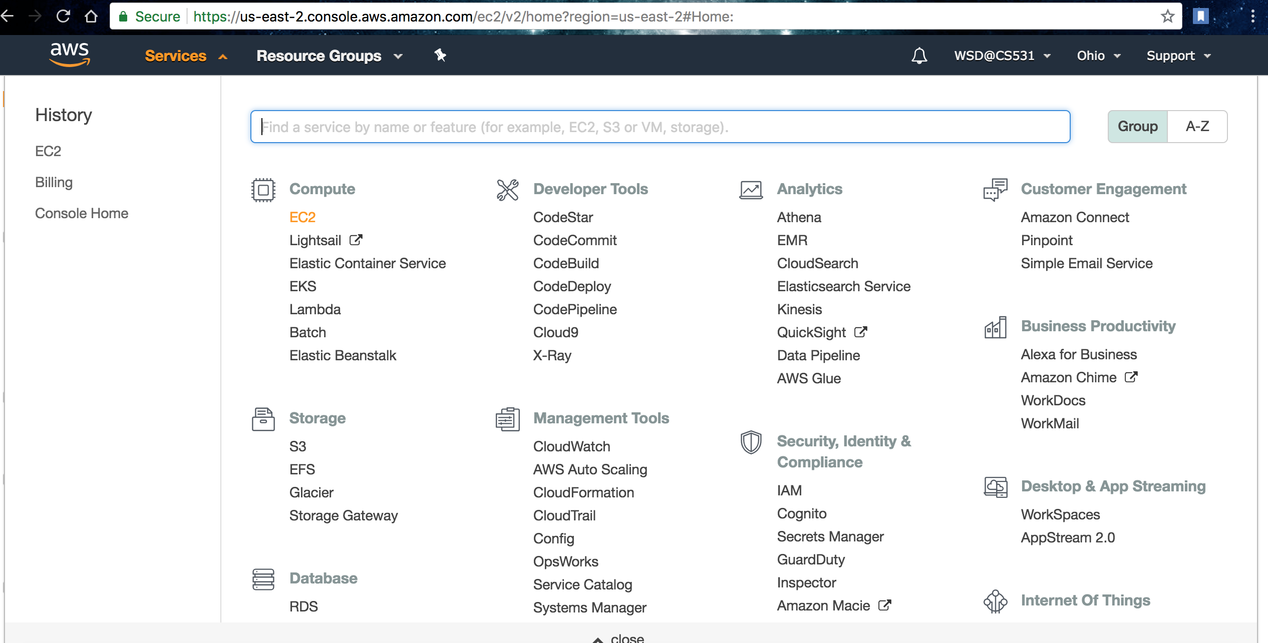
Click on ‘EC2’ under Compute

Slide 8
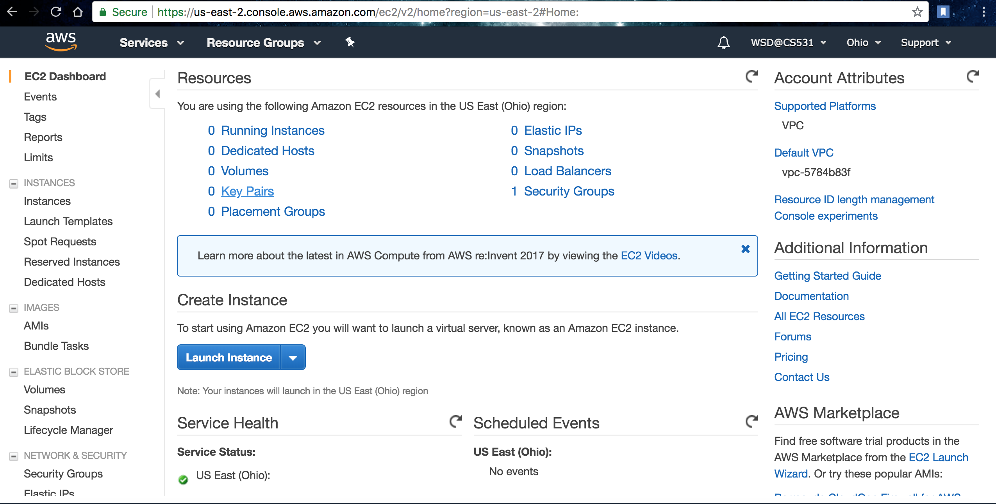
Click on ‘Key Pairs’

Slide 9
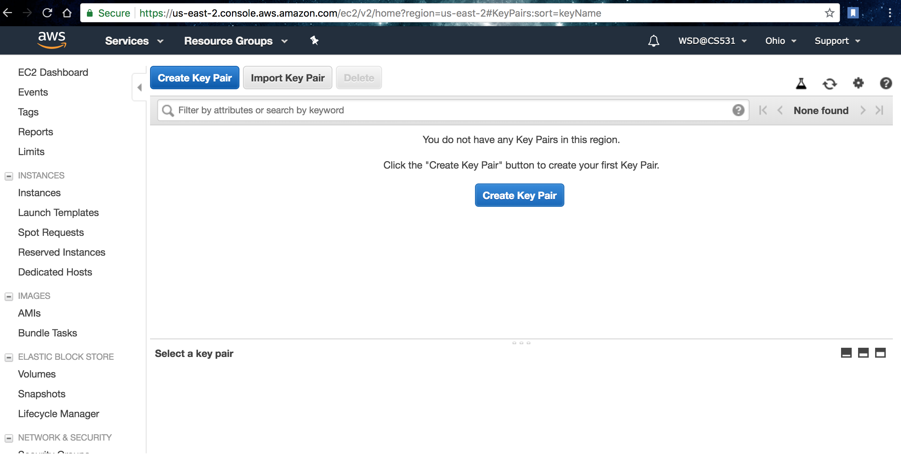
Create a new ‘Key Pair’, to validate yourself…

Slide 10
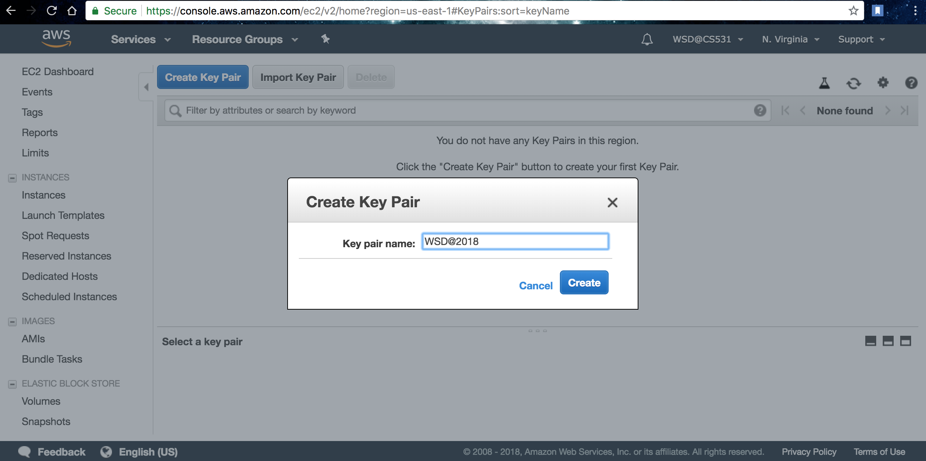

Slide 11
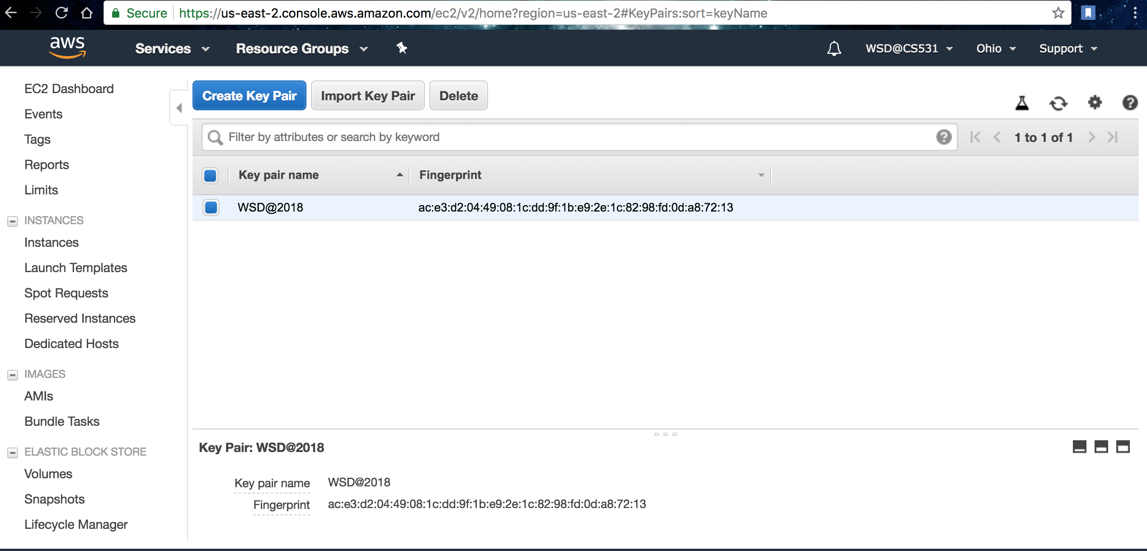

Slide 12
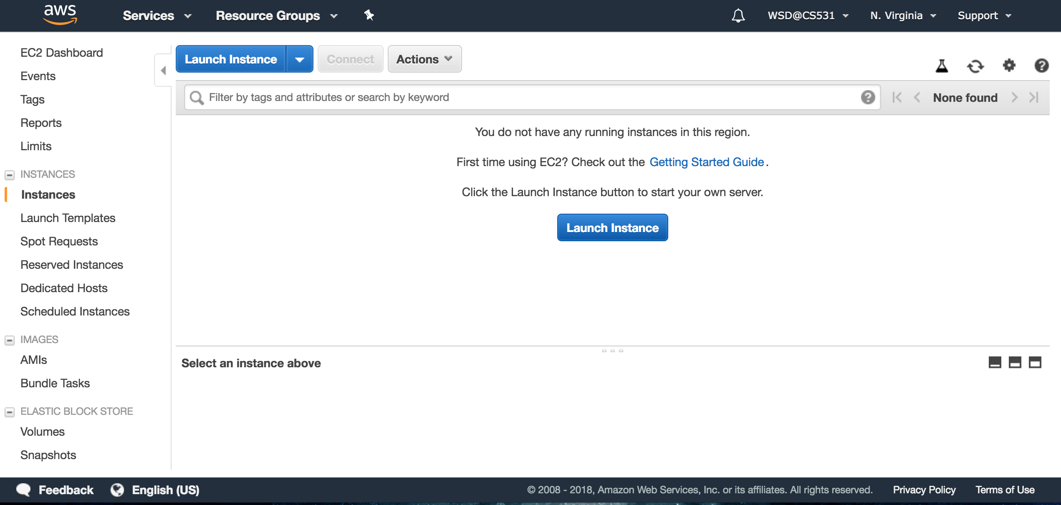
Click on ‘Instances’ followed by ‘Launch Instance’

Slide 13
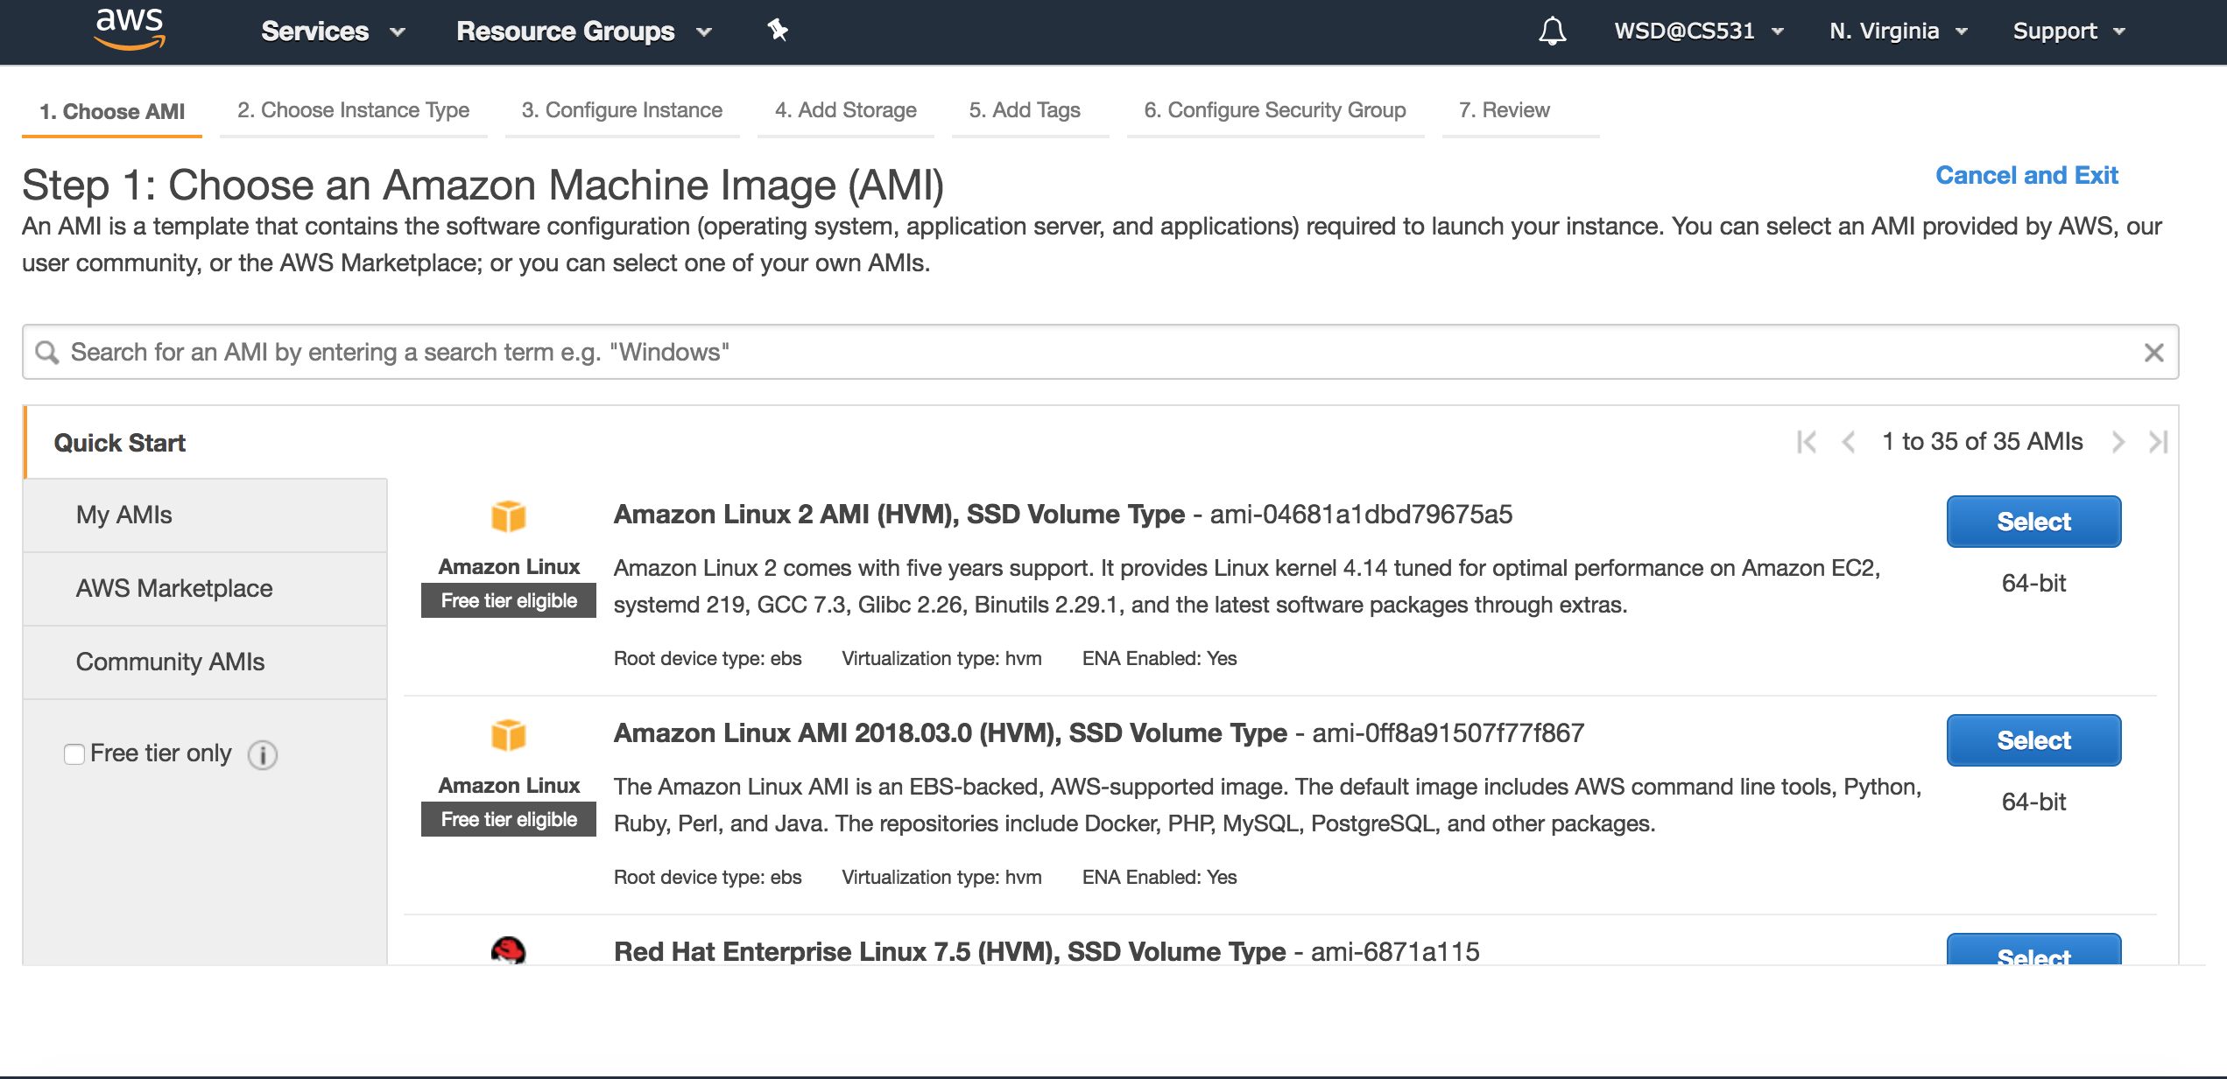
Among the various servers(AMIs),I have opted for‘Linux’

Slide 14
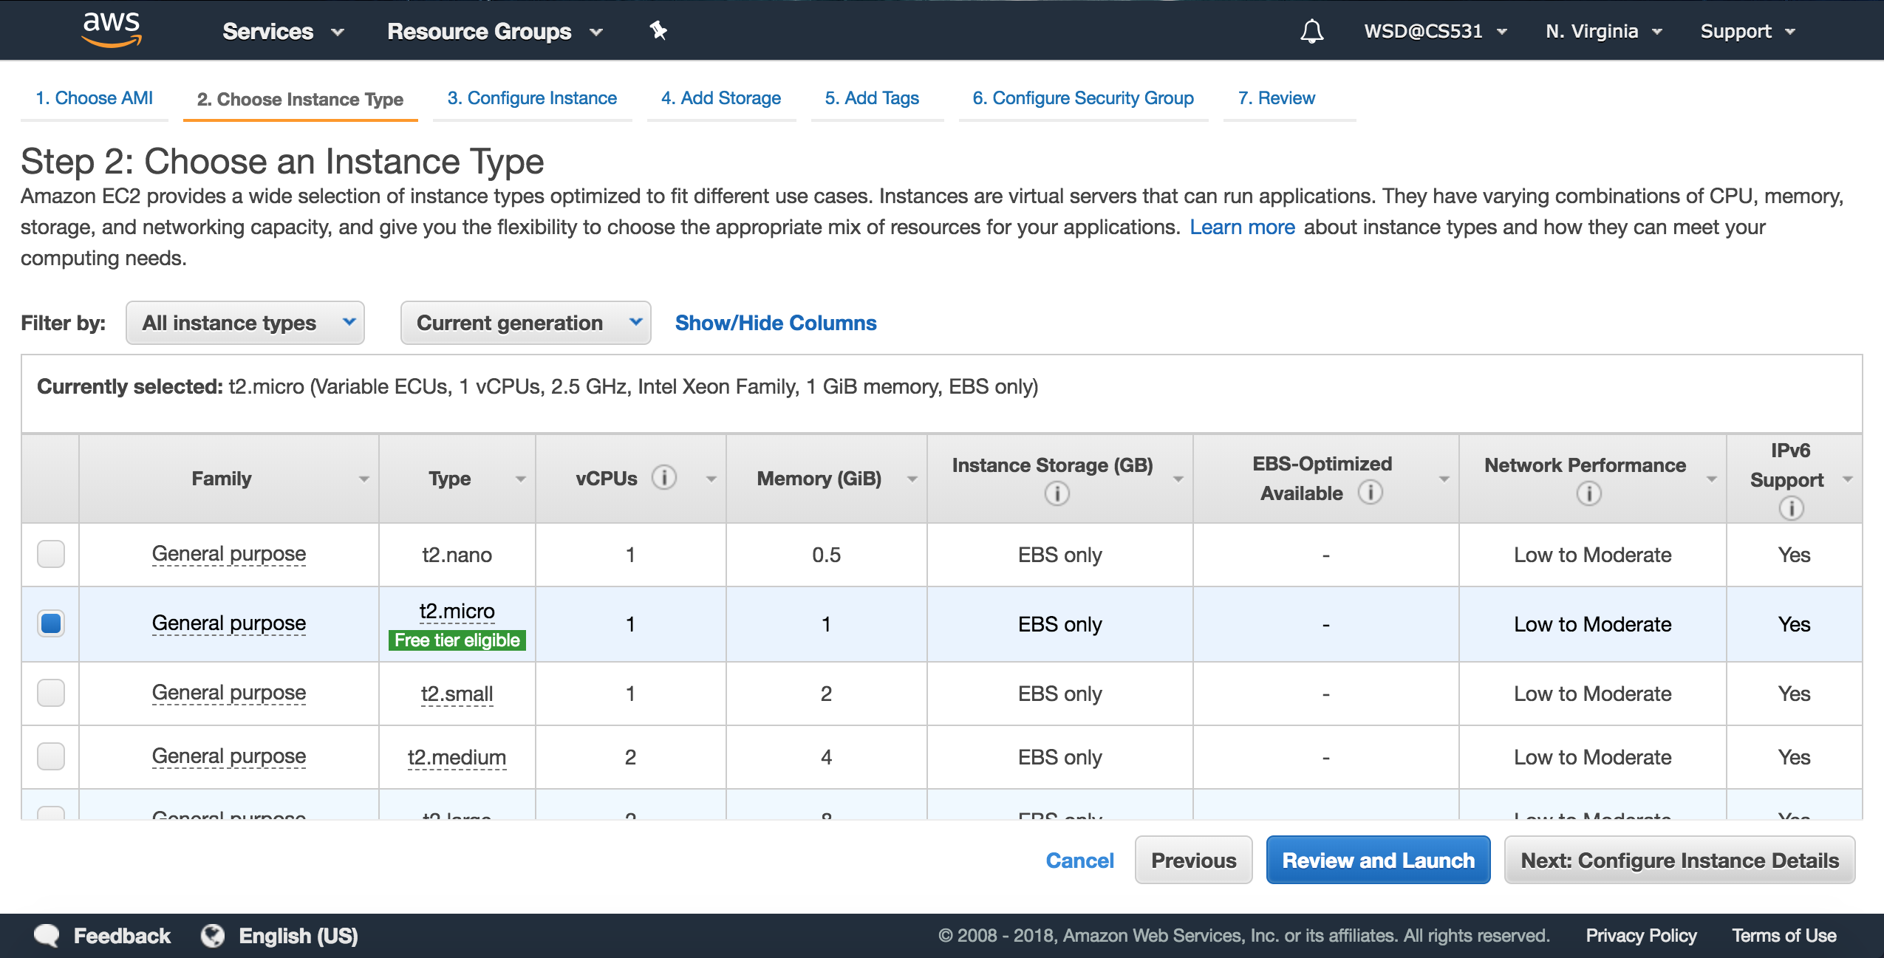
Click on ’Next: Configuration Instance’ keeping the default selection : ‘t2.micro’

Slide 15
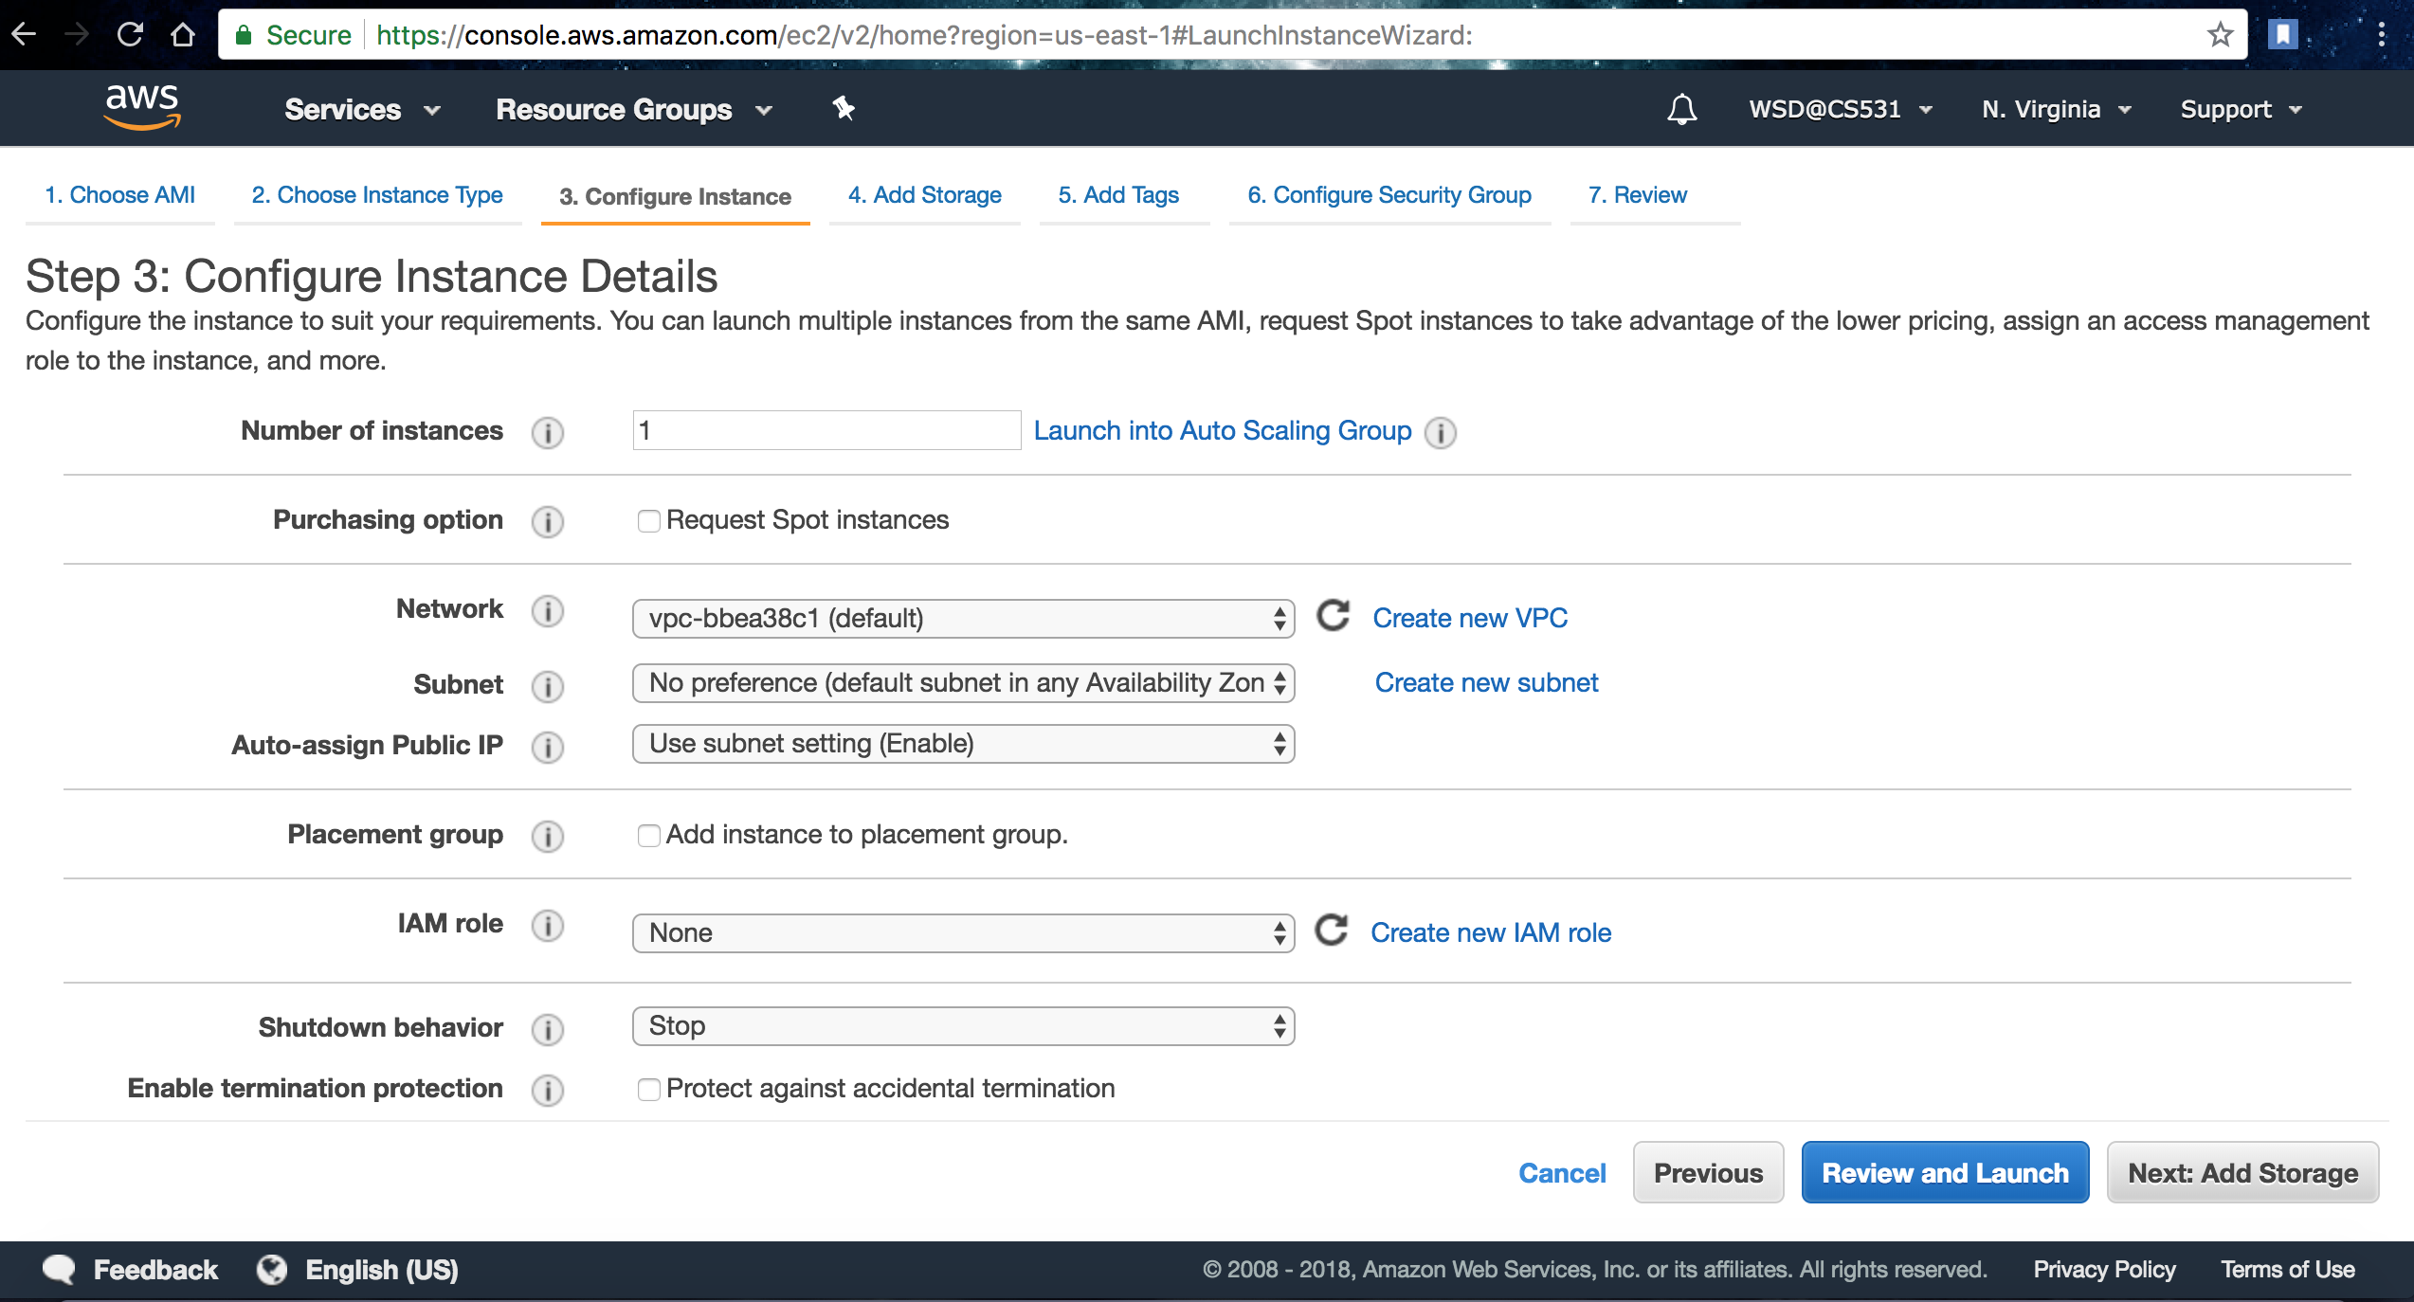
Click on ‘Add Storage’

Slide 16
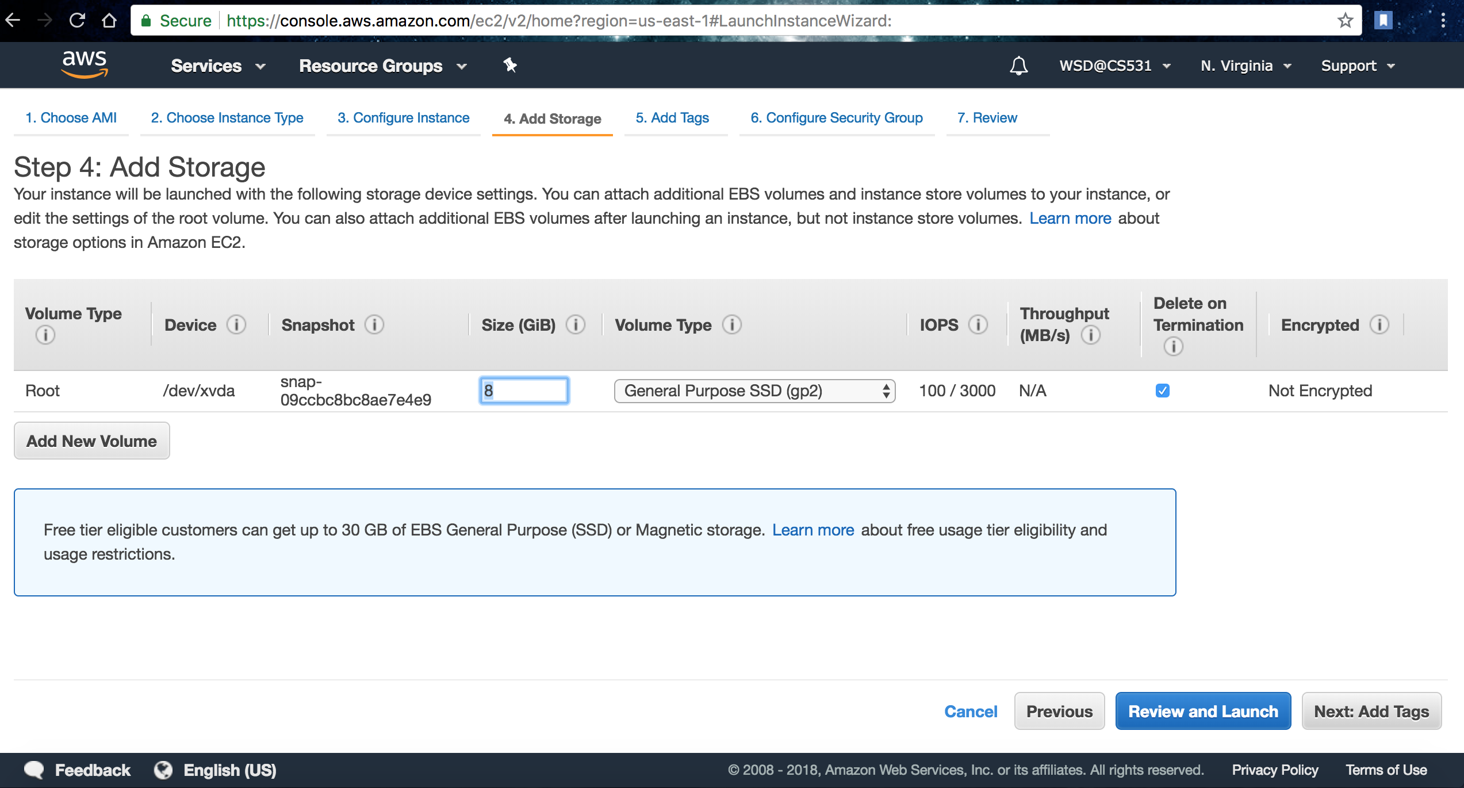
No Changes here…So click on ‘Add Tags’

Slide 17
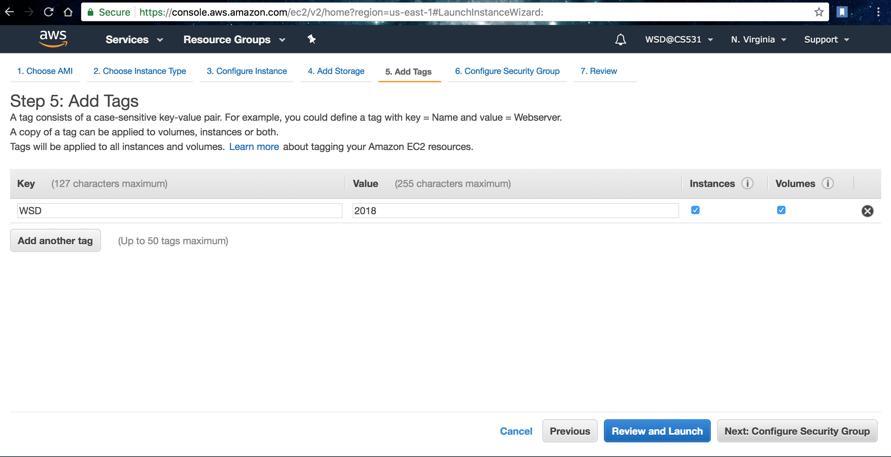
Create new tags with ‘Key’ and ‘Value’

Slide 18
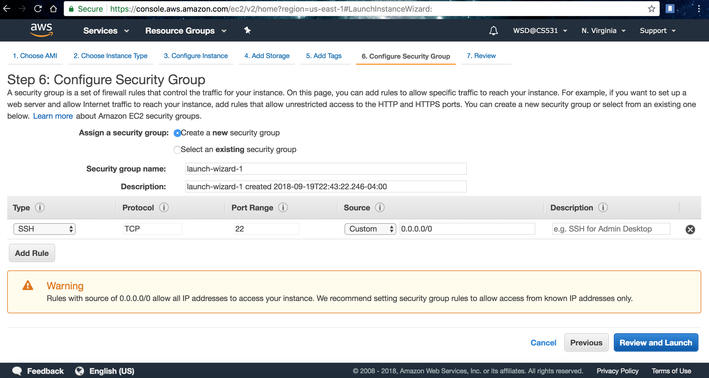
Click on ‘Review and Launch’

Slide 19
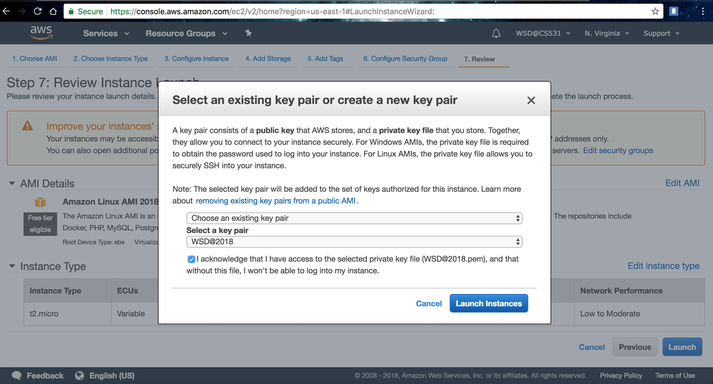
Click on ’Launch’ and select the key-pair,if not create one and save the ‘.pem’ file downloaded for future access. Click ‘Launch Instances’ and ‘View Instances’ to look at the running instances on dashboard.

Slide 20
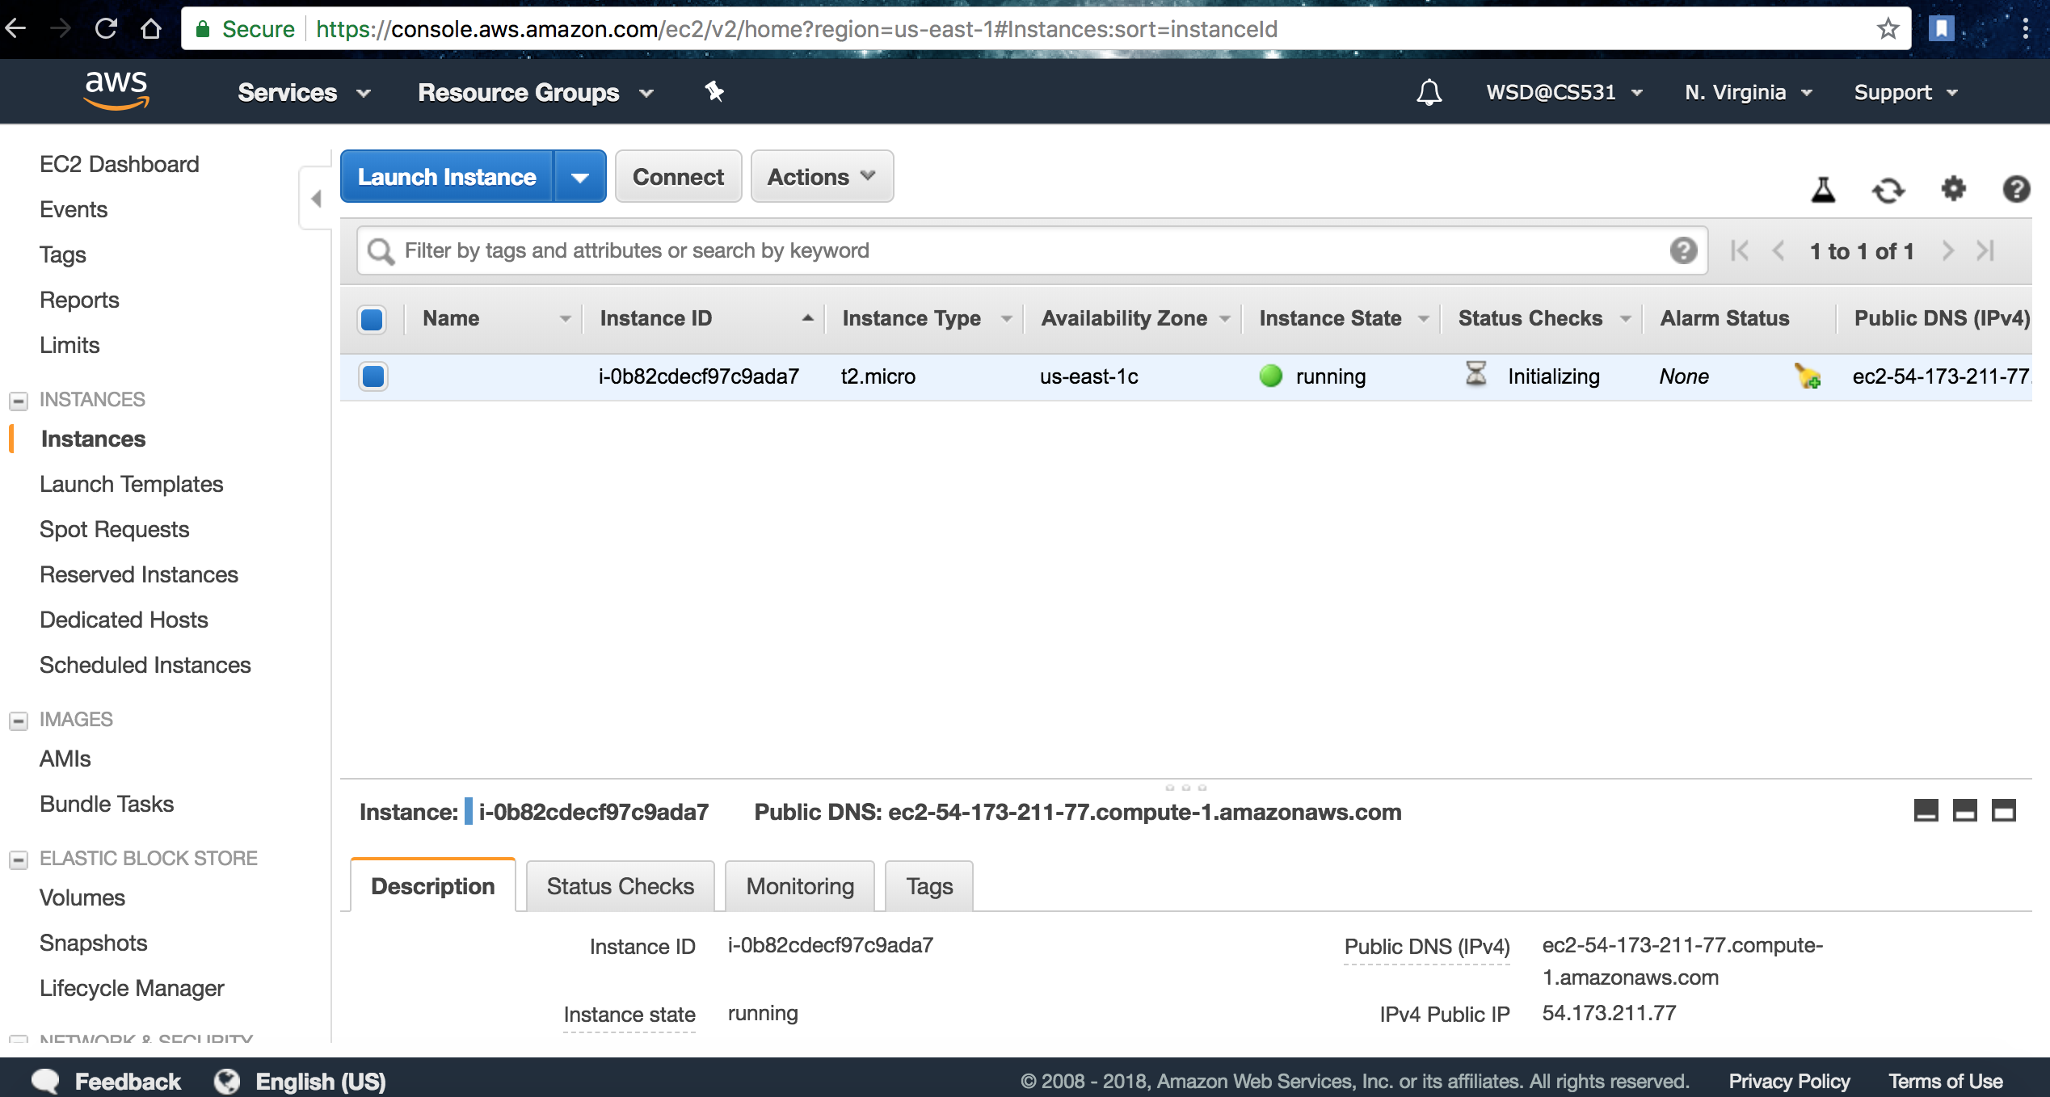

Slide 21
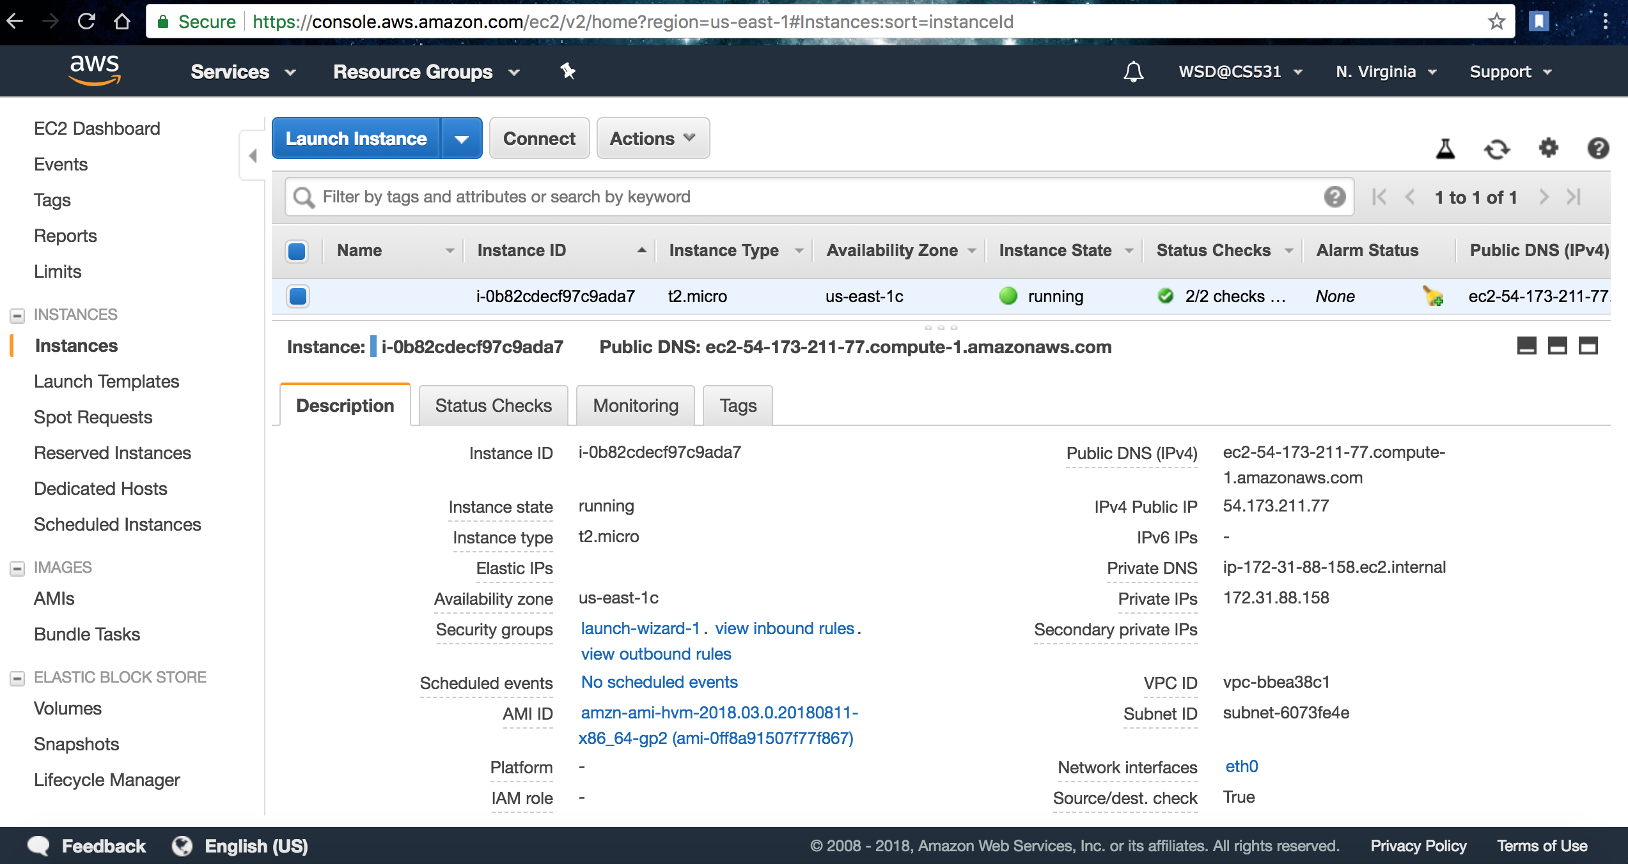
Take a look at the Information panel (bottom half)

Slide 22
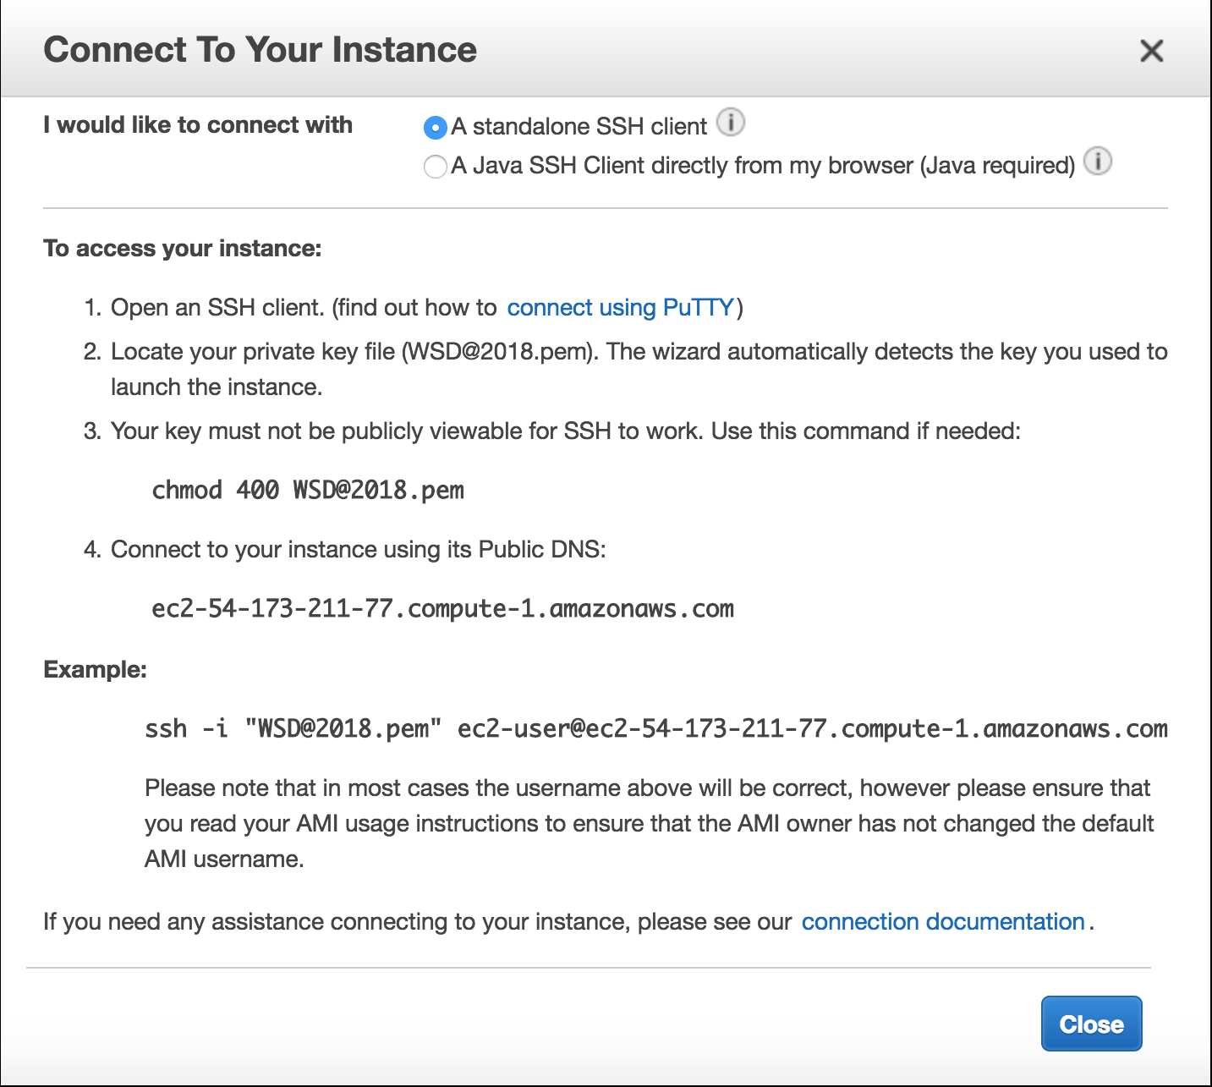
How do I connect to the server(EC2) instance created now…?

